Slide 1

SNOWFLAKE TRAININGs

Slide 2
WHAT WE WILL LEARN
1- TIME TRAVEL
2- HOW IT WORKS
3- HOW WE CAN CONFIGURE IT & MAX RETENTION PERIOD
4- HOW WE CAN ROLL BACK OUR DATA
5- HOW WE CAN ROLLBACK OUR DATABASE,iF MY DATABASE IS DROPPED?
6- FAIL SAFE & HOW IT WORKS
7- COST ASSOICATED WITH IT & HOW WE CAN SEE ASSIGNED BYTES per TABLE
8- What is zero Copy Clone and How it works?
9- How can we check cost associated with all tables during cloning?

Slide 3
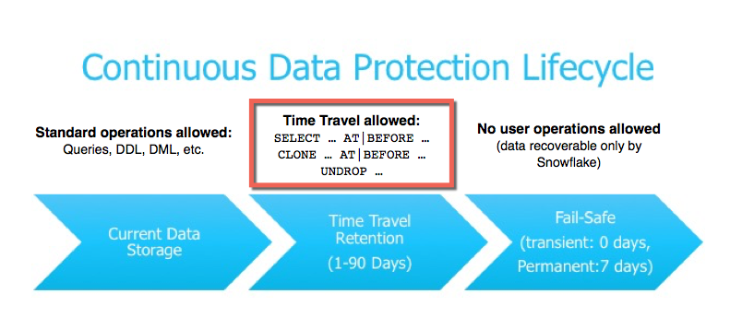
TIME TRAVEL in ACTION
Snowflake TimeTravel features let user access the historical data up to 90days.
Time travel can be used for below points.
Restoring data-related objects (tables, schemas, and databases) that might have been accidentally or intentionally deleted.
Duplicating and backing up data from key points in the past.
Analyzing data usage/manipulation over specified periods of time.

Slide 4
TIME TRAVEL in ACTION
Key Component for Time Travel is Data Retention Period.
Some Important points about Data Retention Period
1-By Default it is 1day(24Hrs) for all Snowflake accounts (in Any Edition)
2-If you update data retention period to 0 days, It means you can not access the historical data.
3- You can update to 90days for Permanent Tables (If you are using Enterprise edition or above)
4-To Update the Retention period :
ALTER TABLE TABLENAME SET DATA_RETENTION_TIME_IN_DAYS=Values;
5-To check your table data retention period :
Run SHOW TABLES <TableName> In Result (Retention_time ) will help you to know about this
Or Run Select * from Database.INFORMATION_SCHEMA.TABLES (It will give you the list of all tables under that database)

Slide 5
TIME TRAVEL in ACTION
Query Historical Data
You can query your deleted data by three ways.
1- At Specific time or day:
Select * from Table at(timestamp => 'Fri, 01 May 2015 16:20:00 -0700'::timestamp_tz);
2-To query for 5/10 min back data :
Select * from Table at (offset =>-60*5);
3- If you want to access for any query id :
select * from table before(statement => '8e5d0ca9-005e-44e6-b858-a8f5b37c5726');

Slide 6
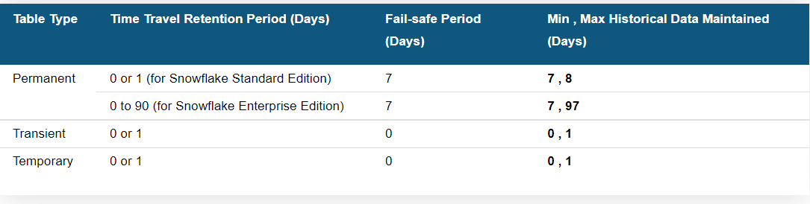
FAIL SAFE
Once our retention time period is over, then our data enter in Fail safe zone.
Fail-safe provides a (non-configurable) 7-day period during which historical data may be recoverable by Snowflake. This period starts immediately after the Time Travel retention period ends.
Fail-safe is not provided as a means for accessing historical data after the Time Travel retention period has ended. It is for use only by Snowflake to recover data that may have been lost or damaged due to extreme operational failures.

Slide 7
ZERO COPY CLONE
Important points to remember
1- Snowflake clone object create independent Metadata object but refer the same micro partitions. 2- As it refer the same Micro Partitions so no storage cost associated with it.
3- Cloned and Parent objects both are independent and there will not be any impact if we update other.
4- We can clone DATABASE,SCHEMA and all SCHEMA level objects.
5-If we clone the Database then Except Internal Stage and External tables all objects will be copied.
6-IF We clone Database then no Role access will be copied for Database level but Child object like Schema and Tables access will be copied.
7- If we have table with Sequence and Cluster key and we clone then these two will also be cloned.

Slide 8

THANK YOU

